Slide 1
App Engine, Services, APIs, Github

Slide 2
PAAS

Slide 3
Quotas

Slide 4
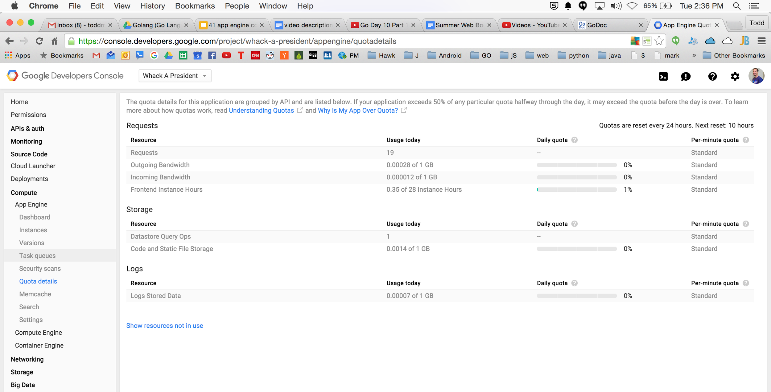

Slide 5
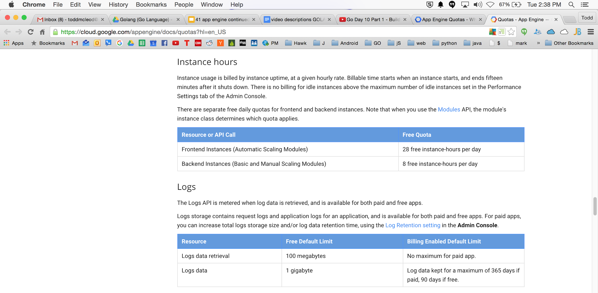

Slide 6
Allows Growth
Datastore
GCS
Compute Engine
Managed VM’s (IAAS++)
Cloud SQL
memcache

Slide 7
sandbox environment

Slide 8
Sandbox
Can’t use the “unsafe” package
can’t write files
use cloud storage instead
outbound http requests
use the services they provide to make outbound http requests

Slide 9
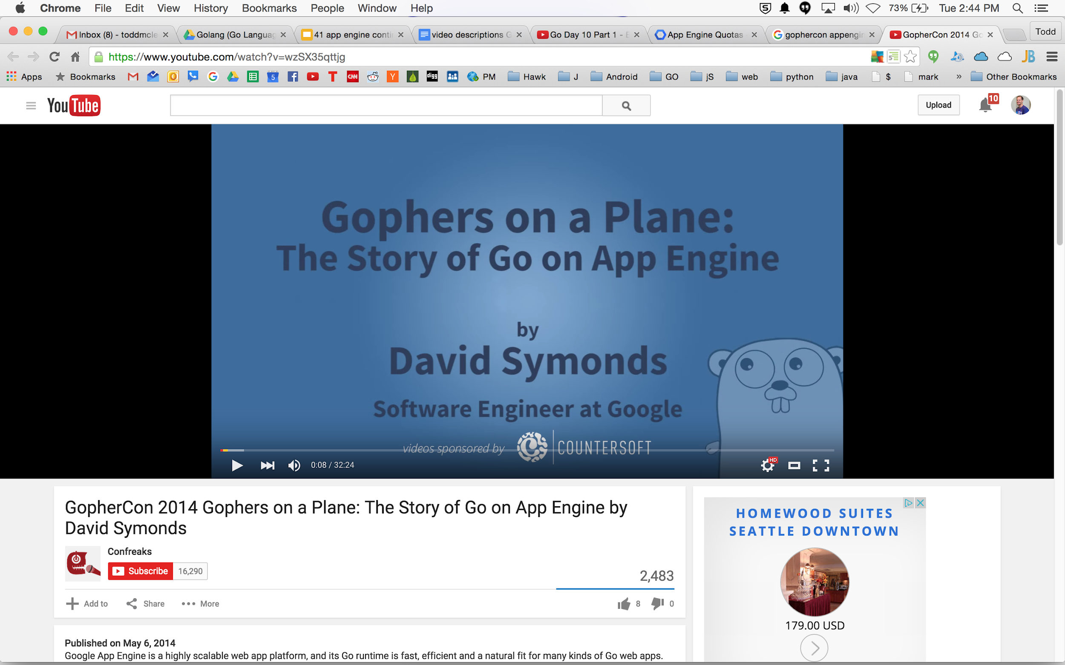

Slide 10
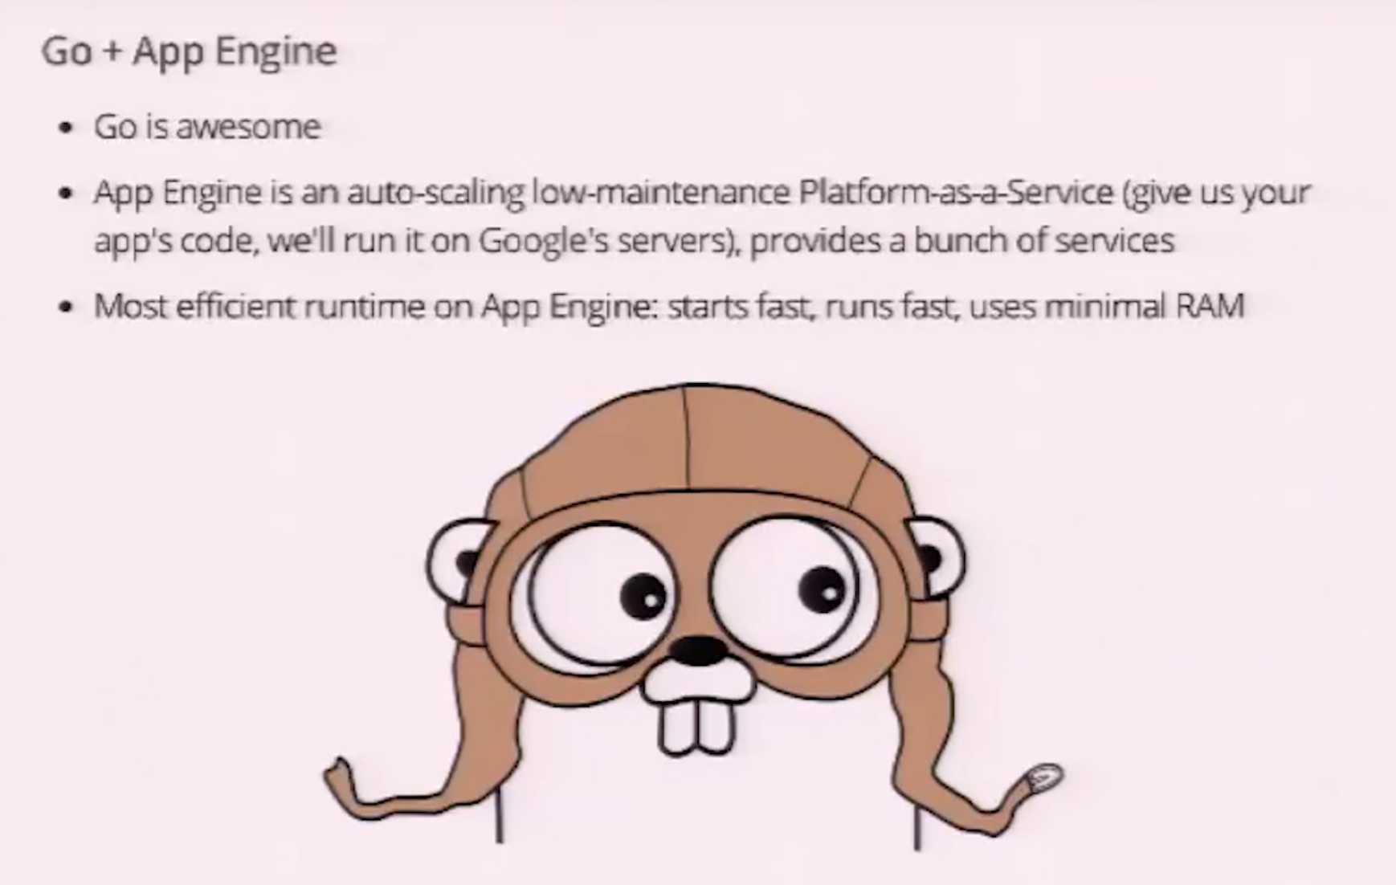

Slide 11
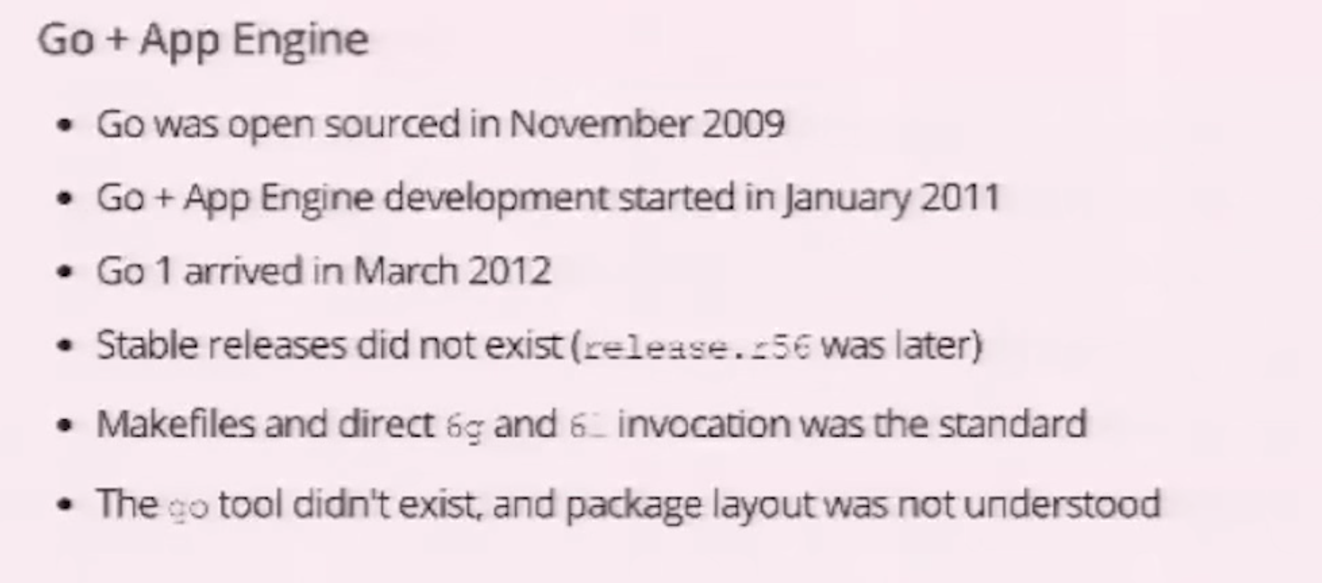

Slide 12
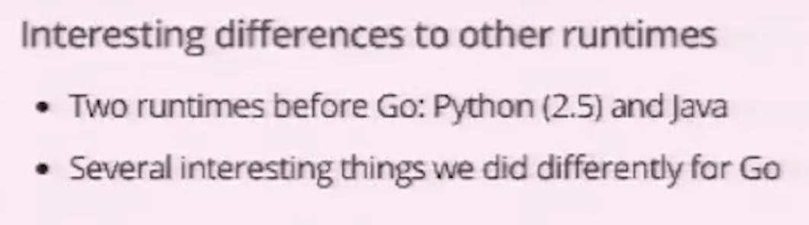

Slide 13
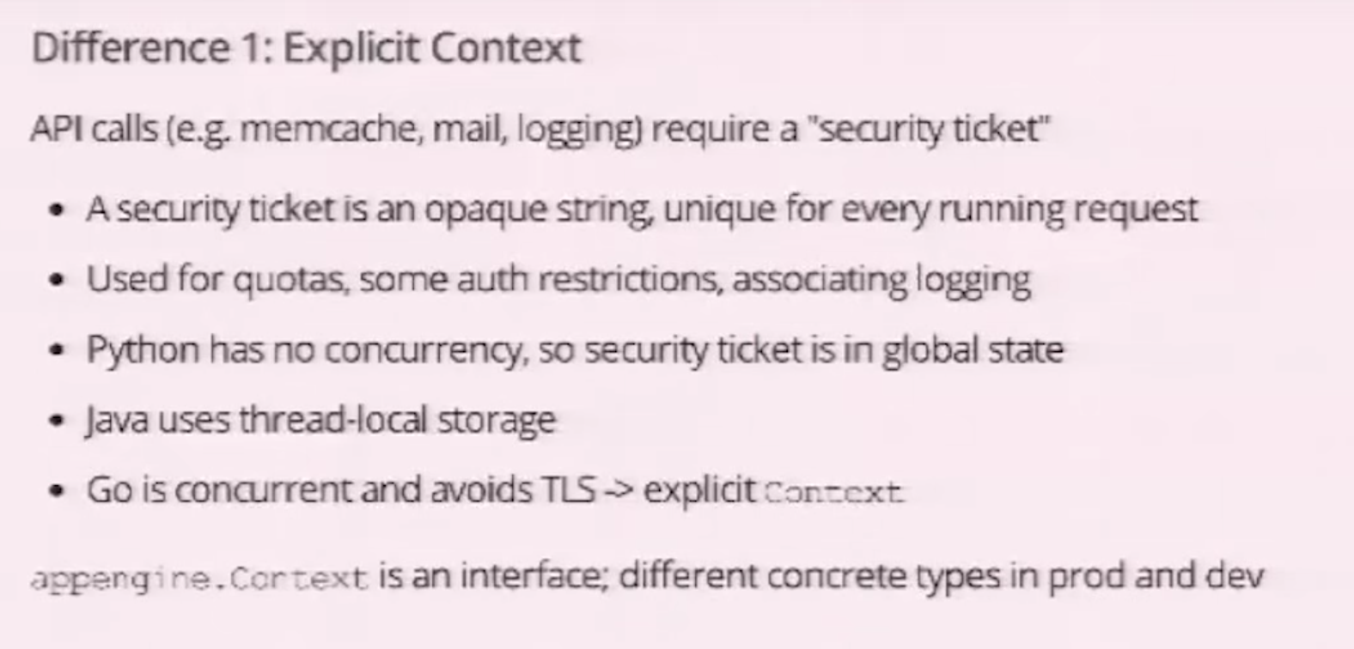

Slide 14
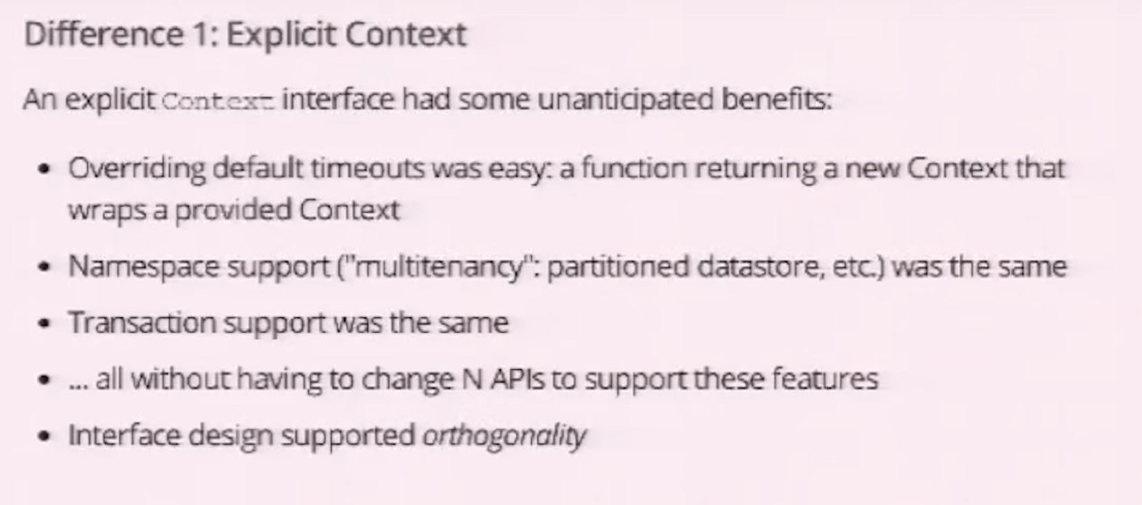

Slide 15
Go on App Engine
Much easier than other languages
Python
Java
Php
Go
Just the net/http package with go

Slide 16
vendor lock-in

Slide 17
app layout

Slide 18
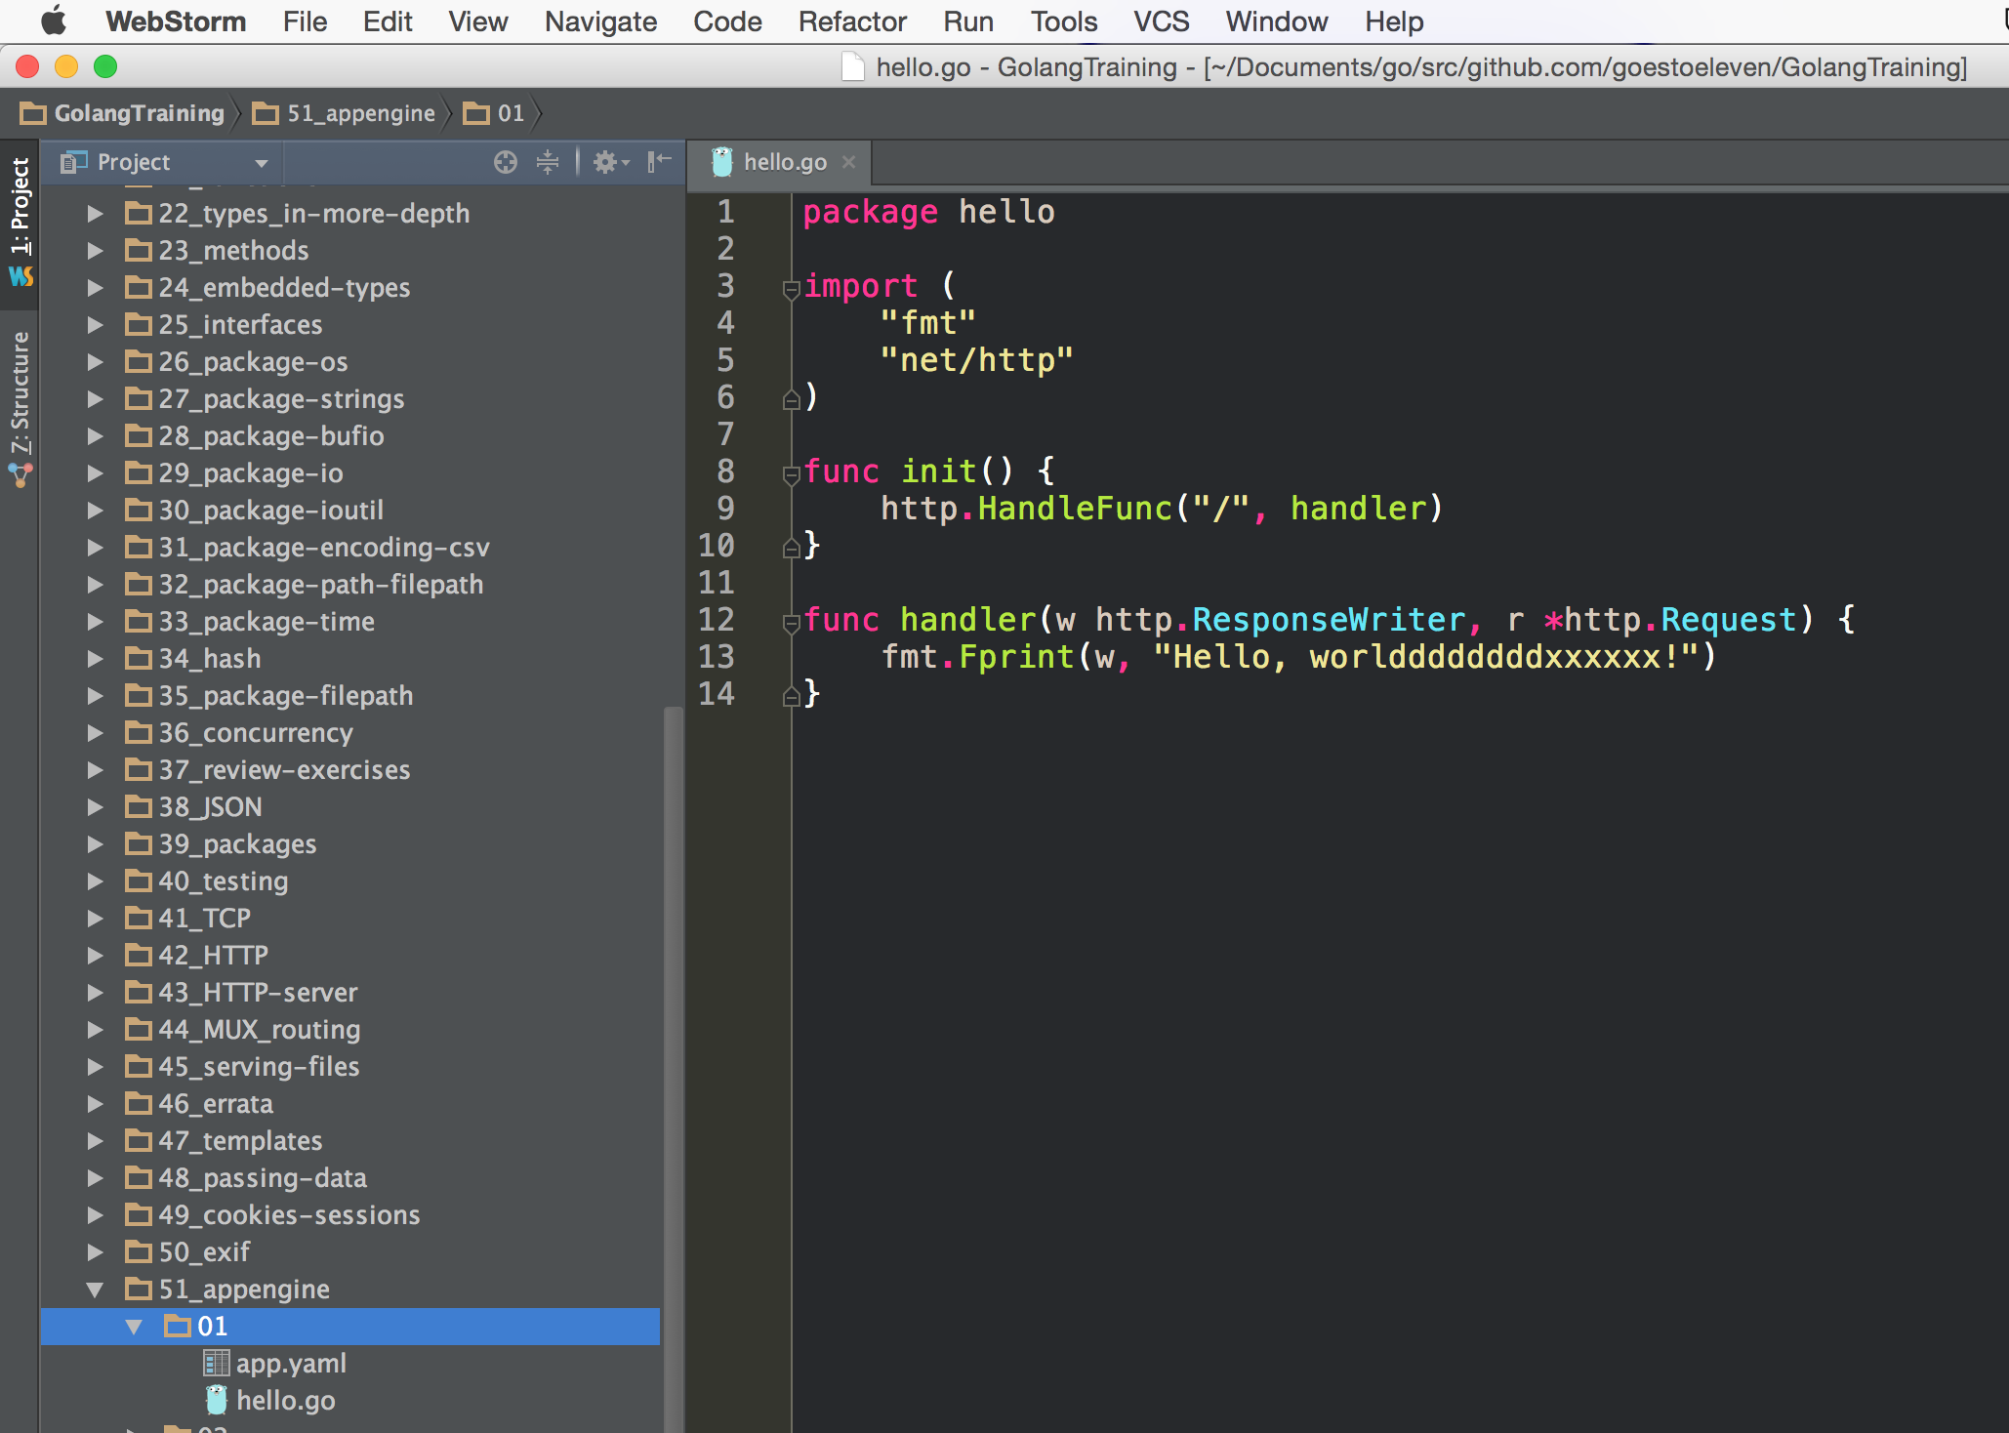
Package name can be anything you want
Put your code in init instead of main
Don’t use func main(){}

Slide 19
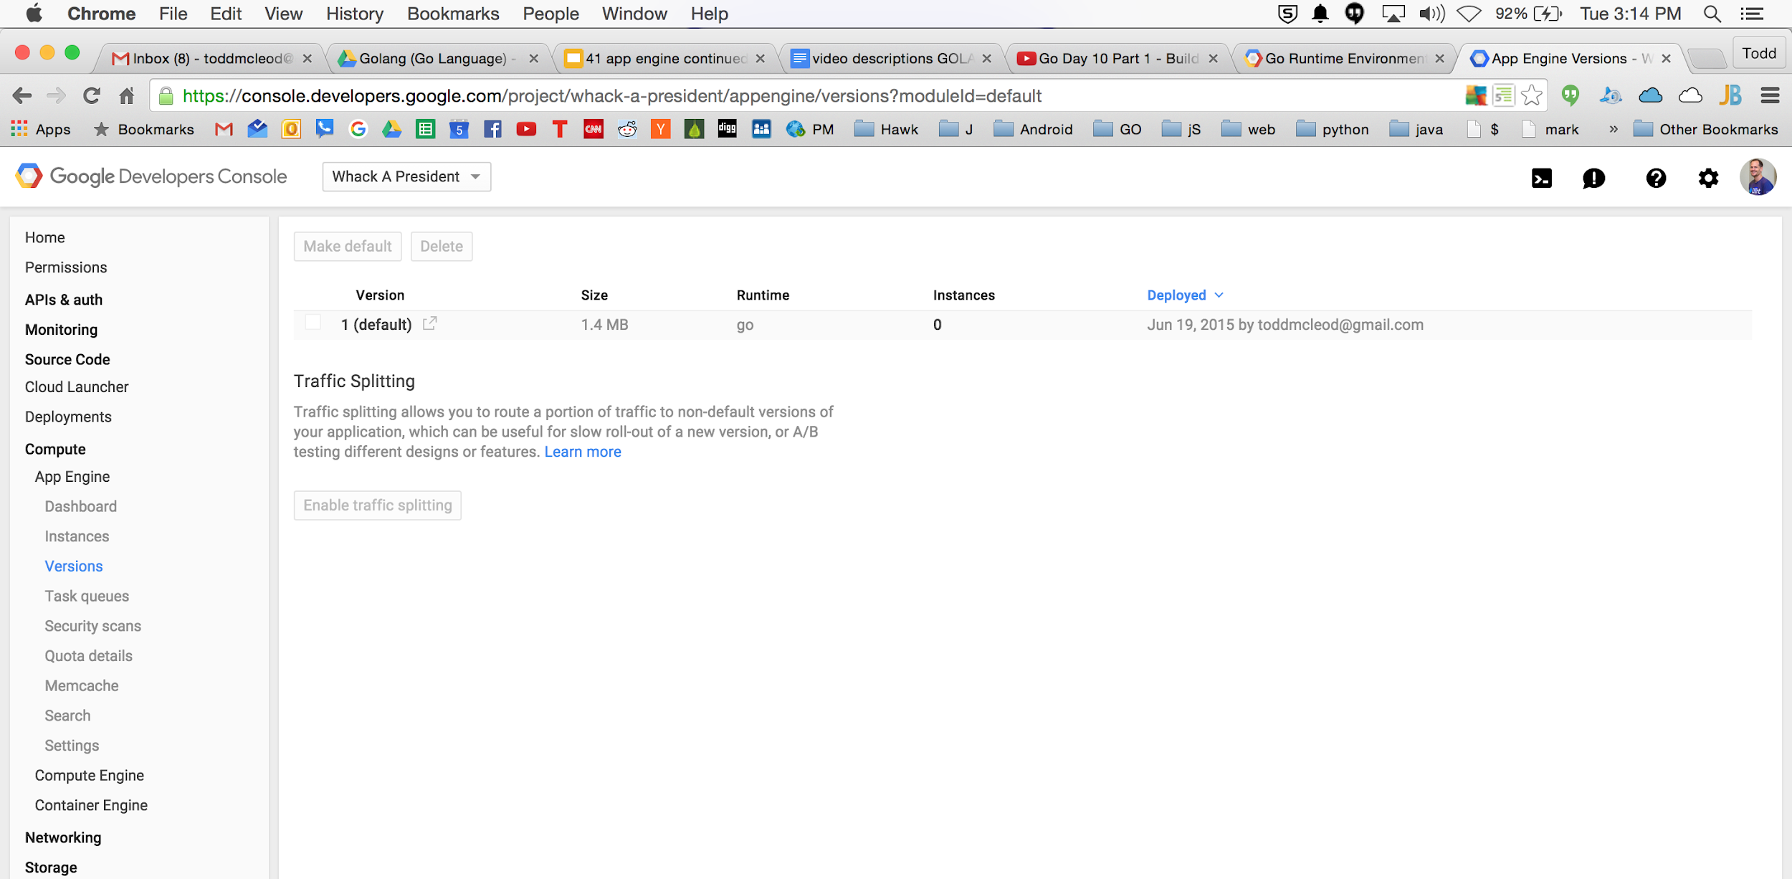

Slide 20
logs

Slide 21
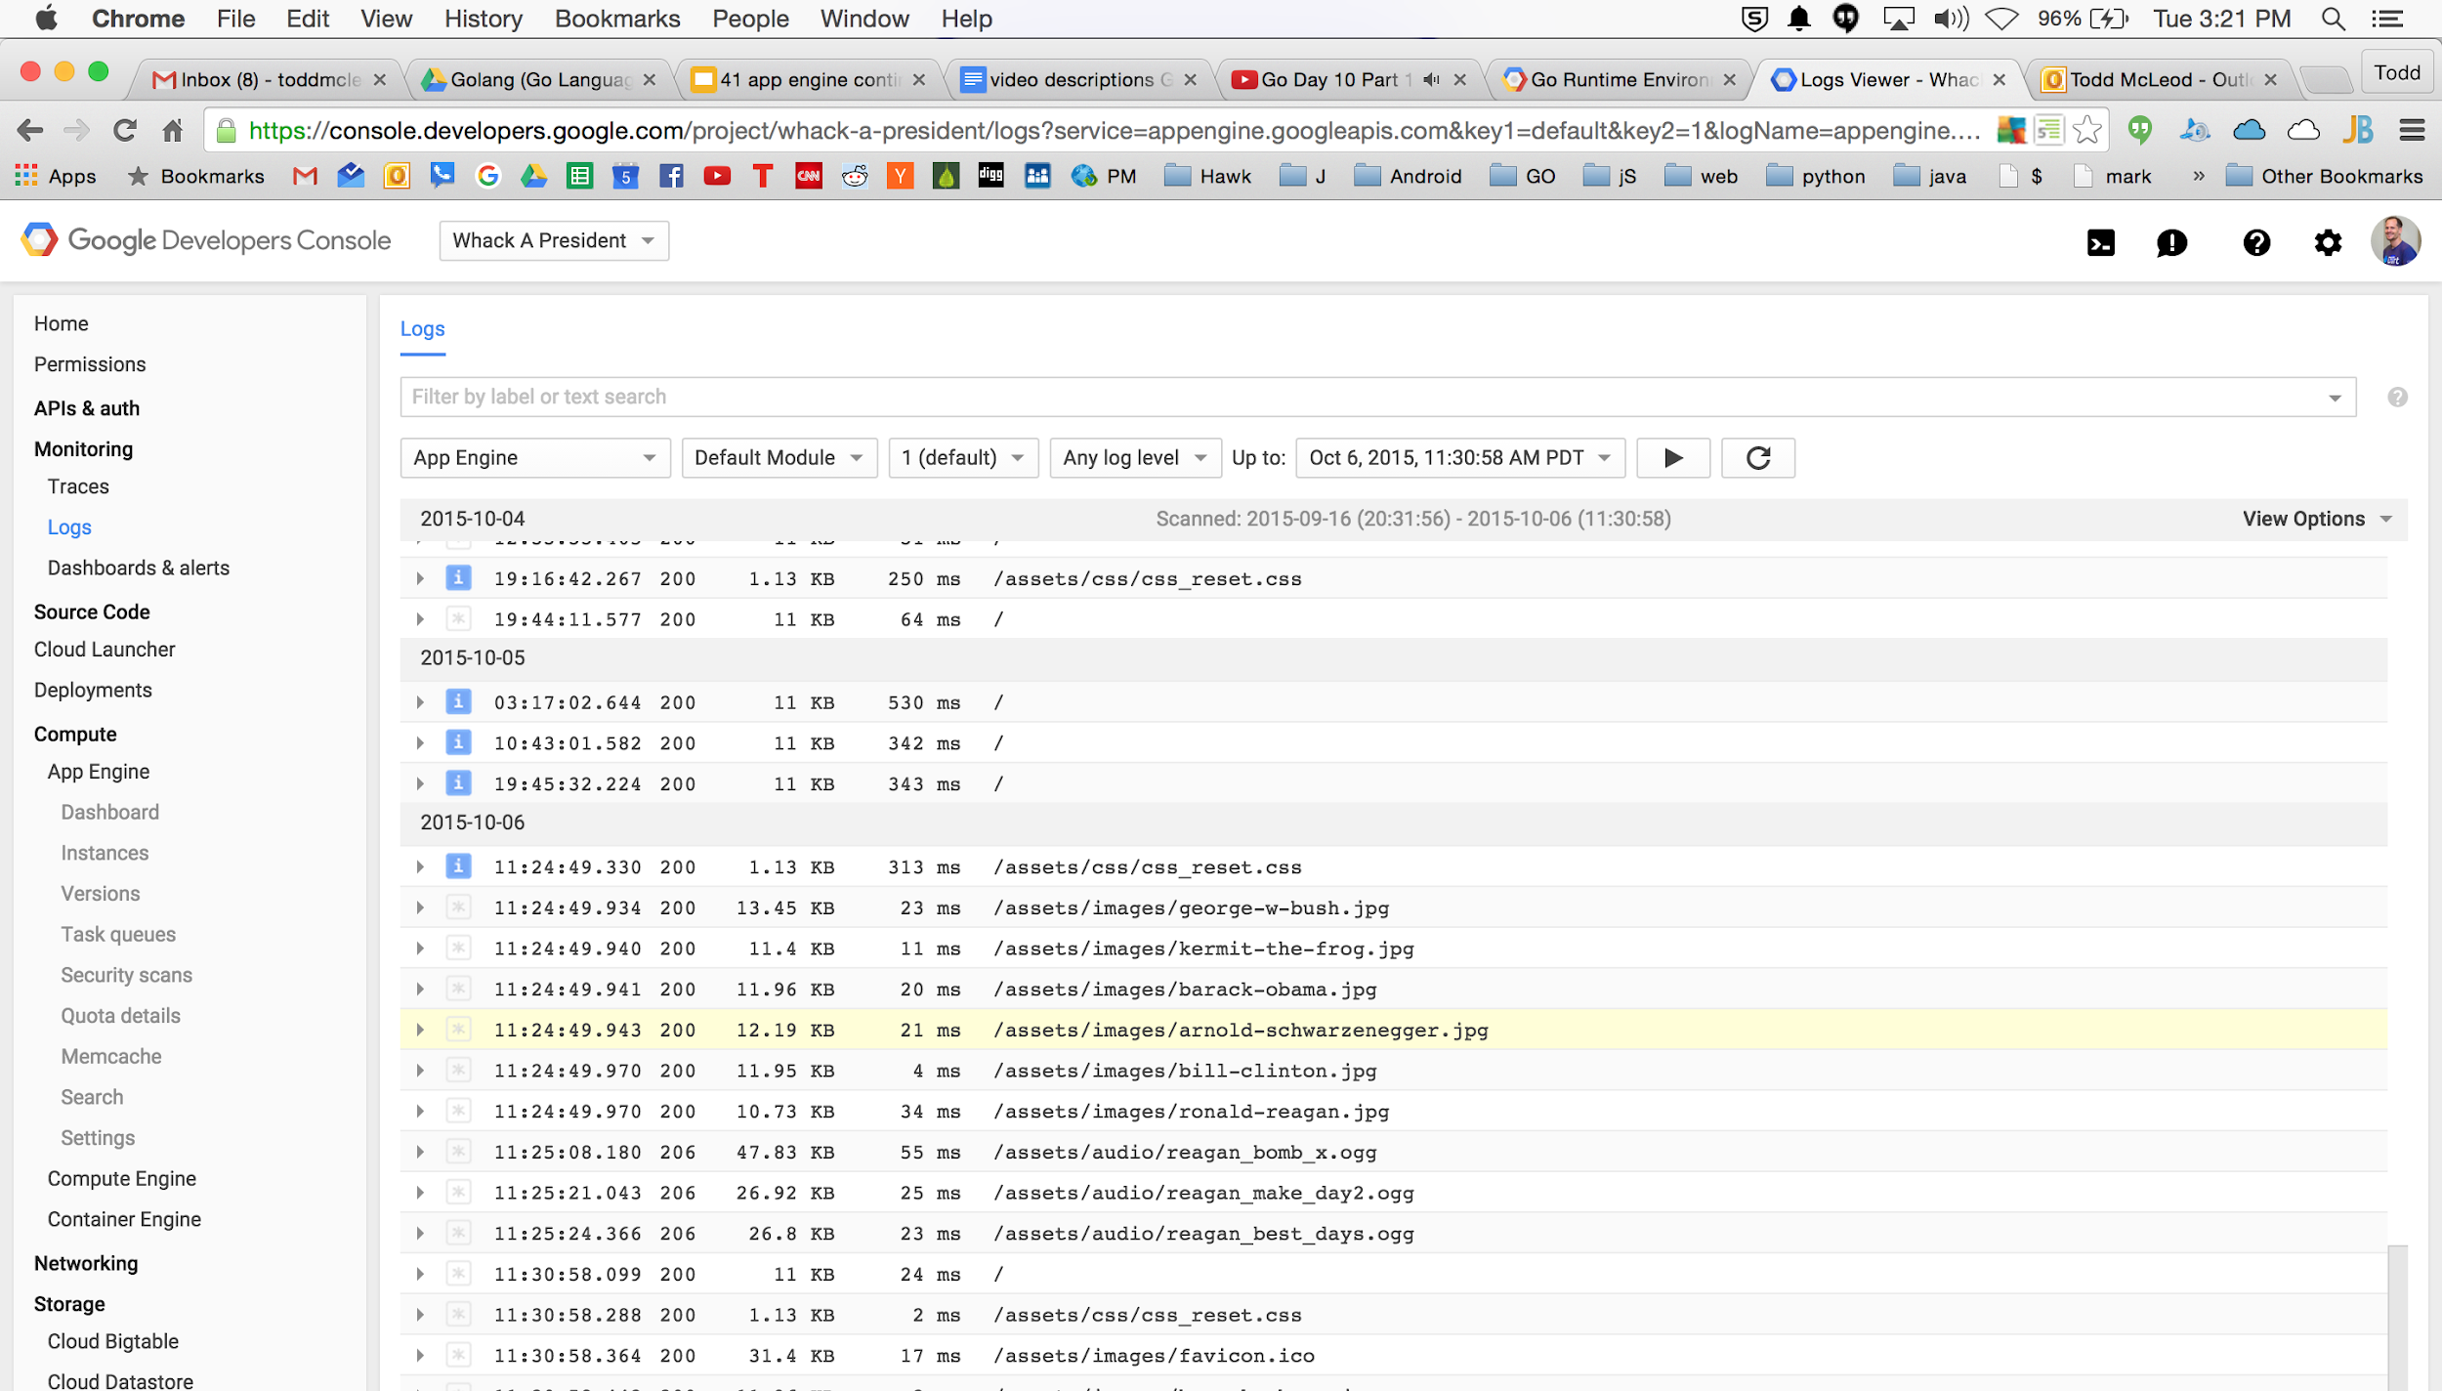
When you have a crash, you’ll see a stack for every go routine.

Slide 22
deploy

Slide 23
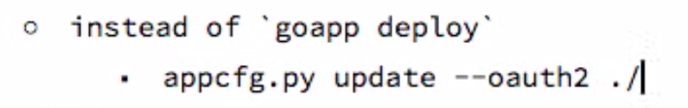

Slide 24
github

Slide 25
Typical process
create a github branch
make a change
commit it
push it
code review
merge it to master
redeploy

Slide 26
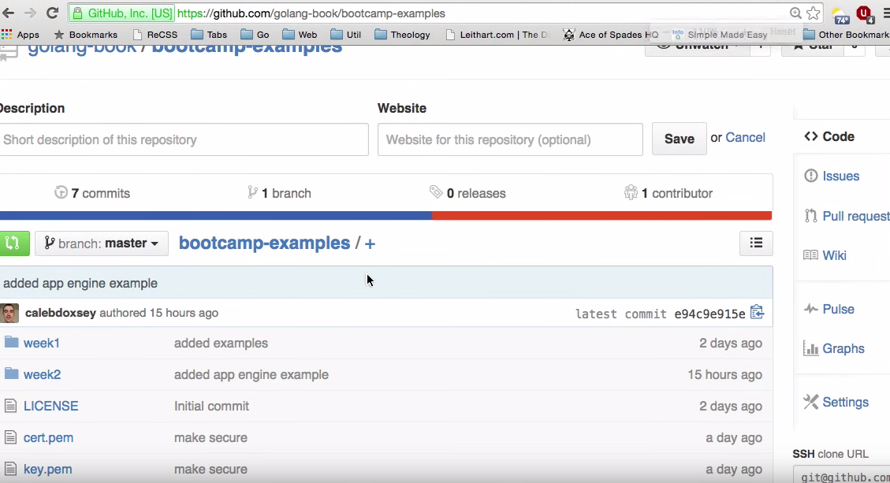

Slide 27
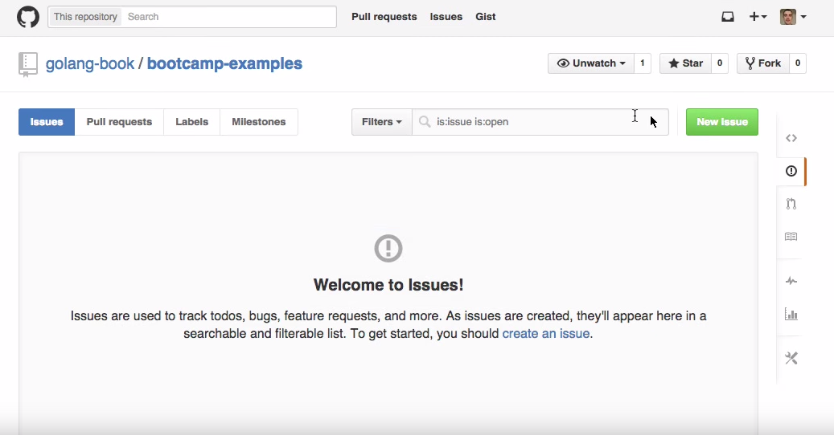

Slide 28
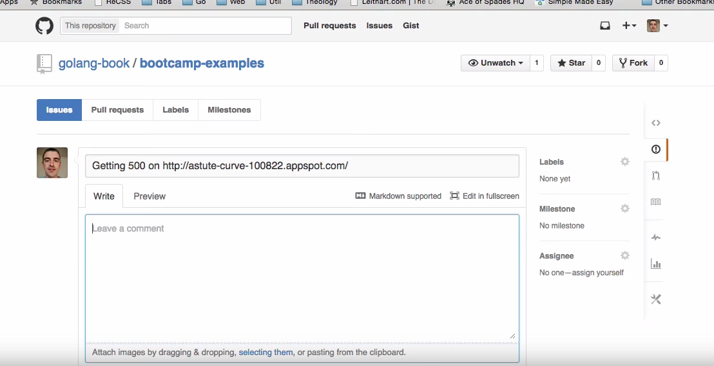

Slide 29
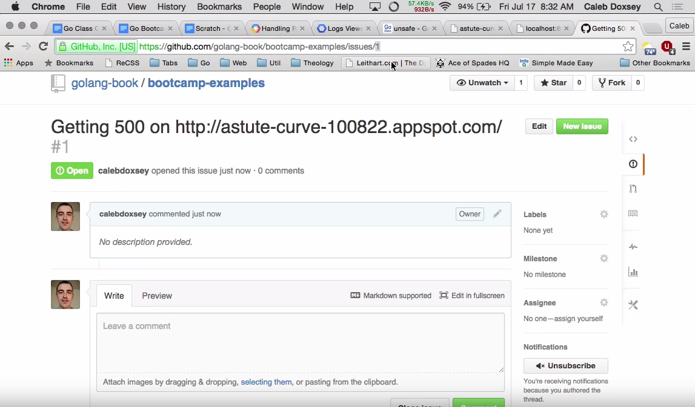
issue number

Slide 30
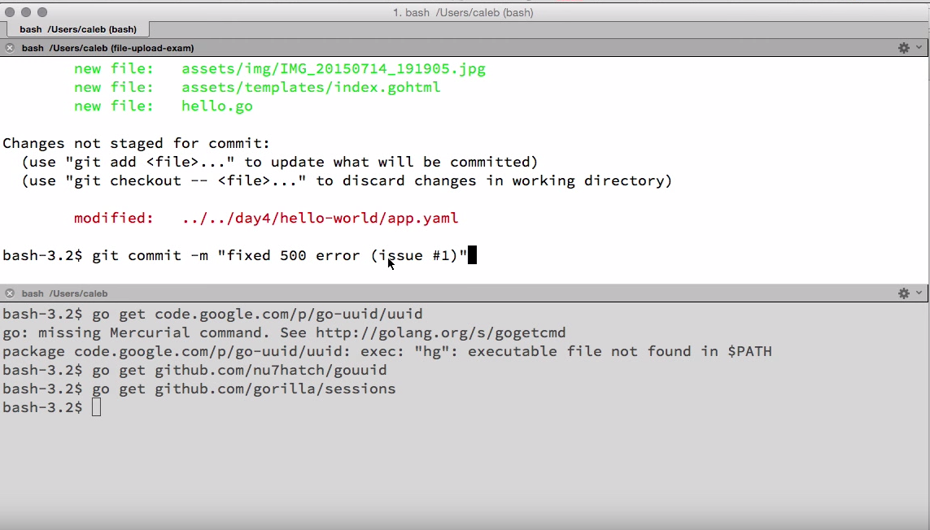
issue number
doing this automatically connects commit to issue in github

Slide 31
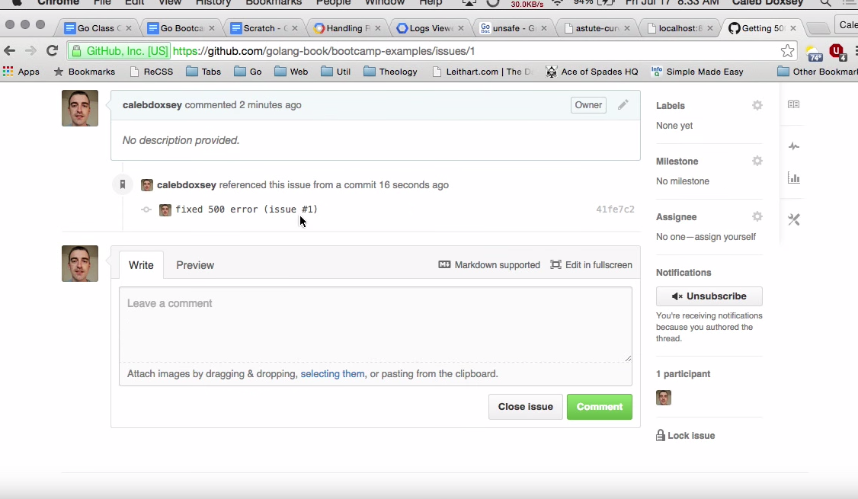
automatically connects commit to issue in github

Slide 32
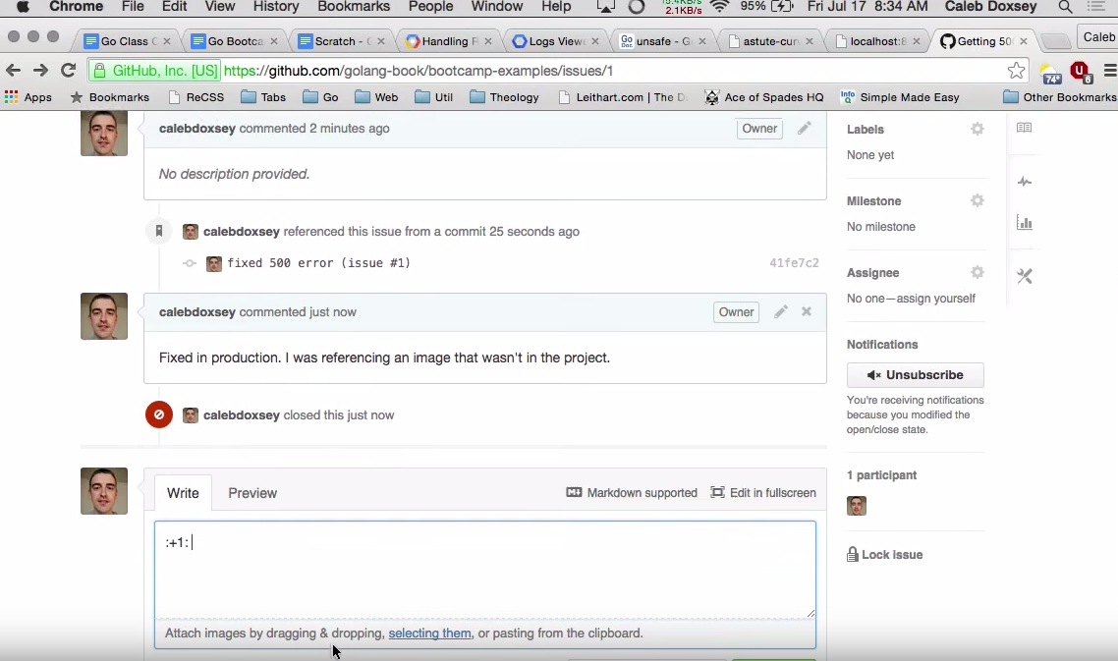
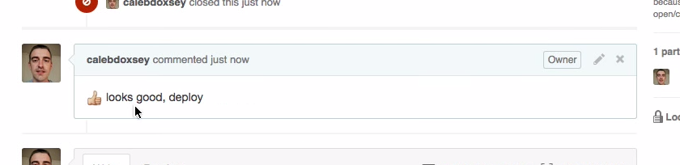

Slide 33
API’s

Slide 34
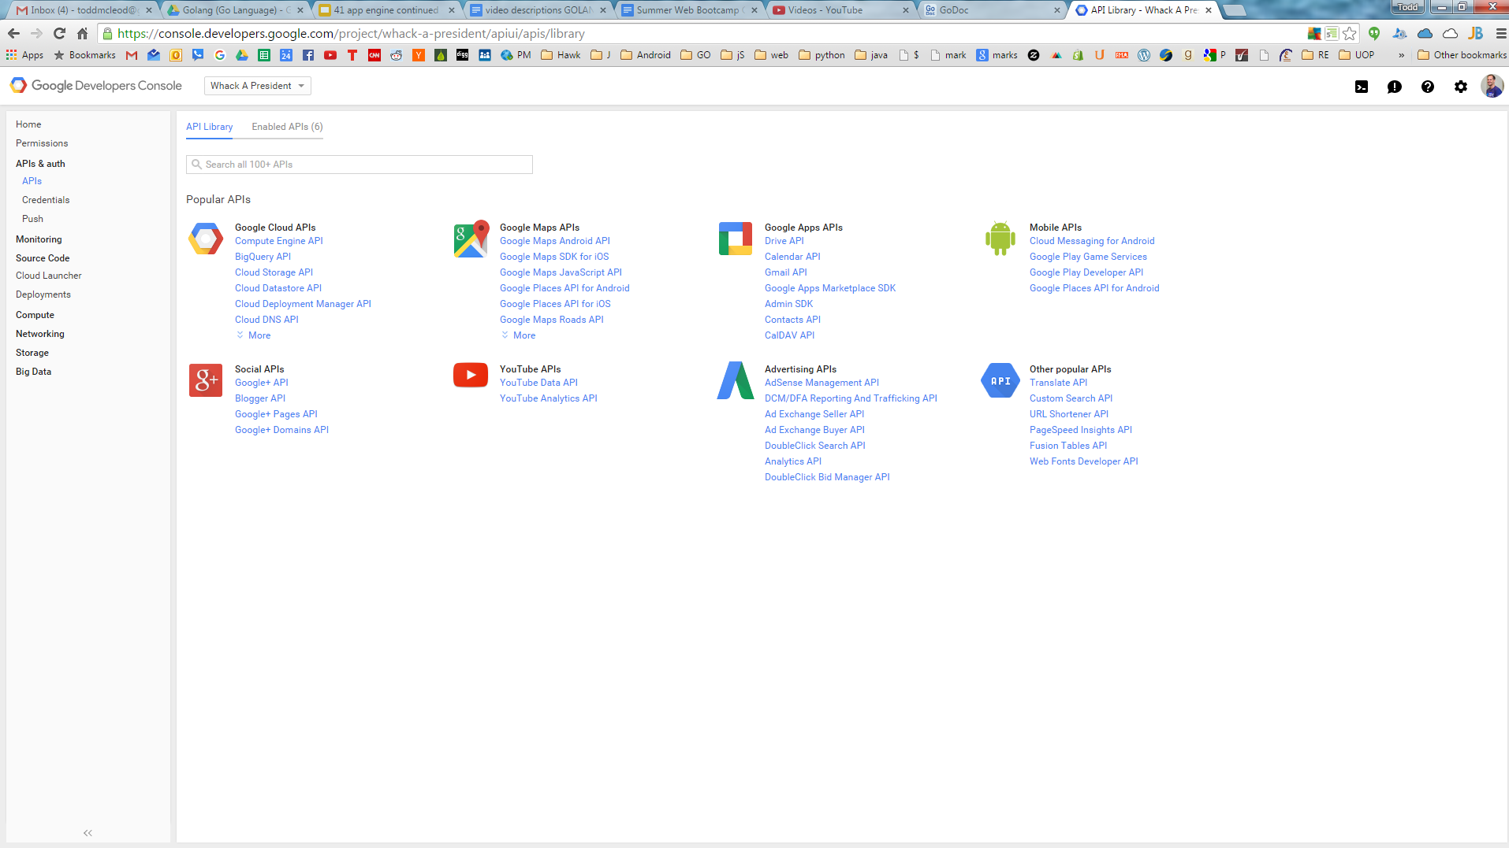

Slide 35
google maps API

Slide 36
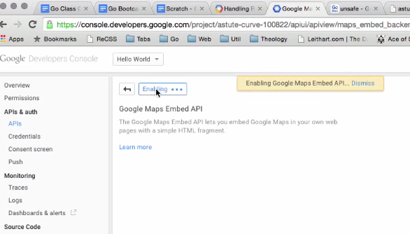

Slide 37
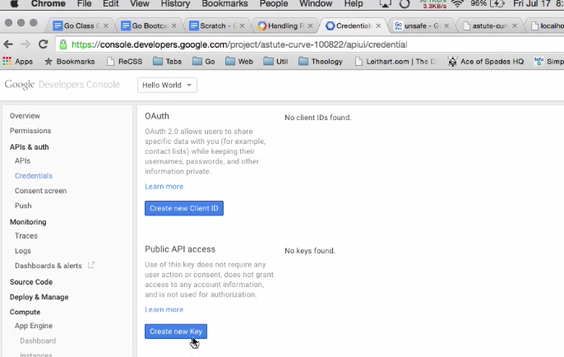

Slide 38
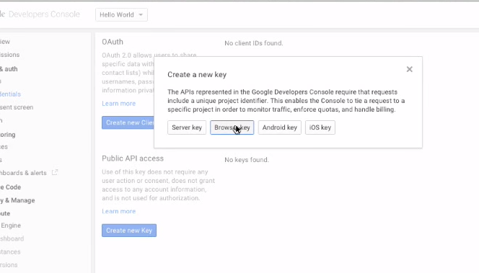

Slide 39
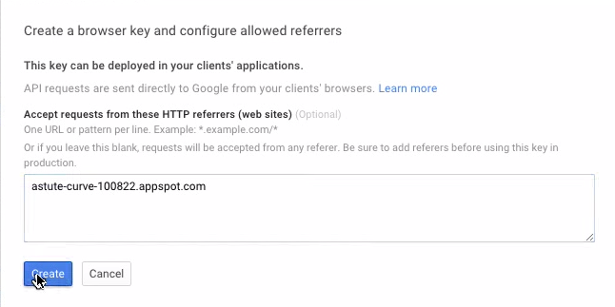

Slide 40
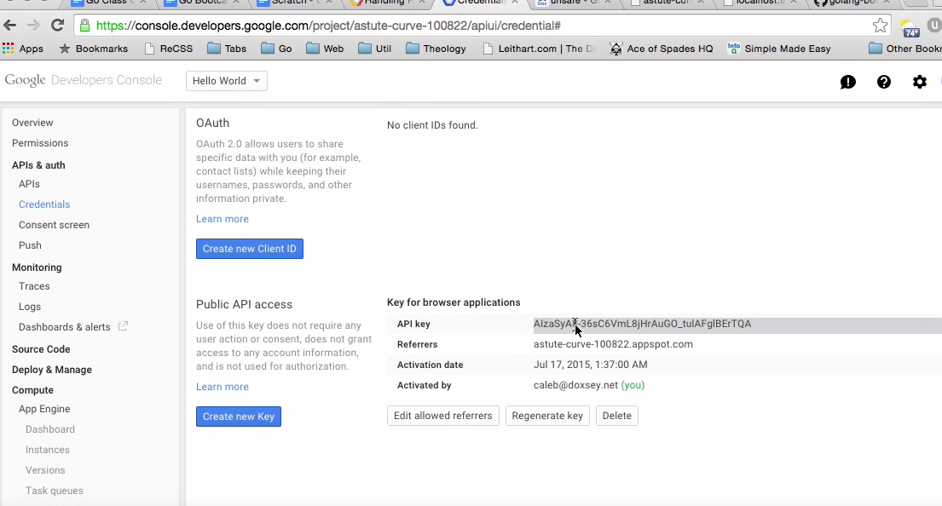

Slide 41
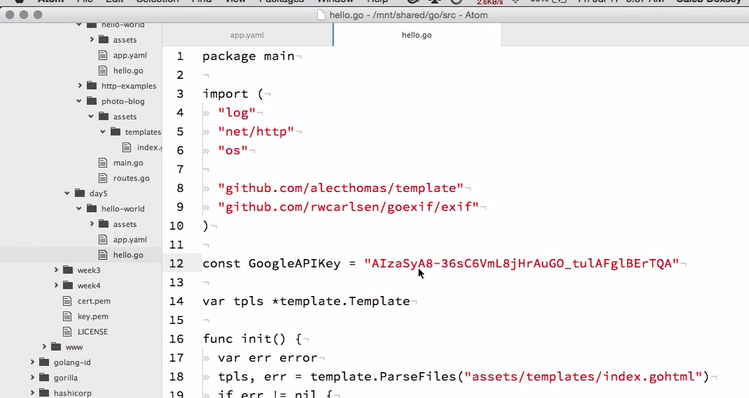

Slide 42
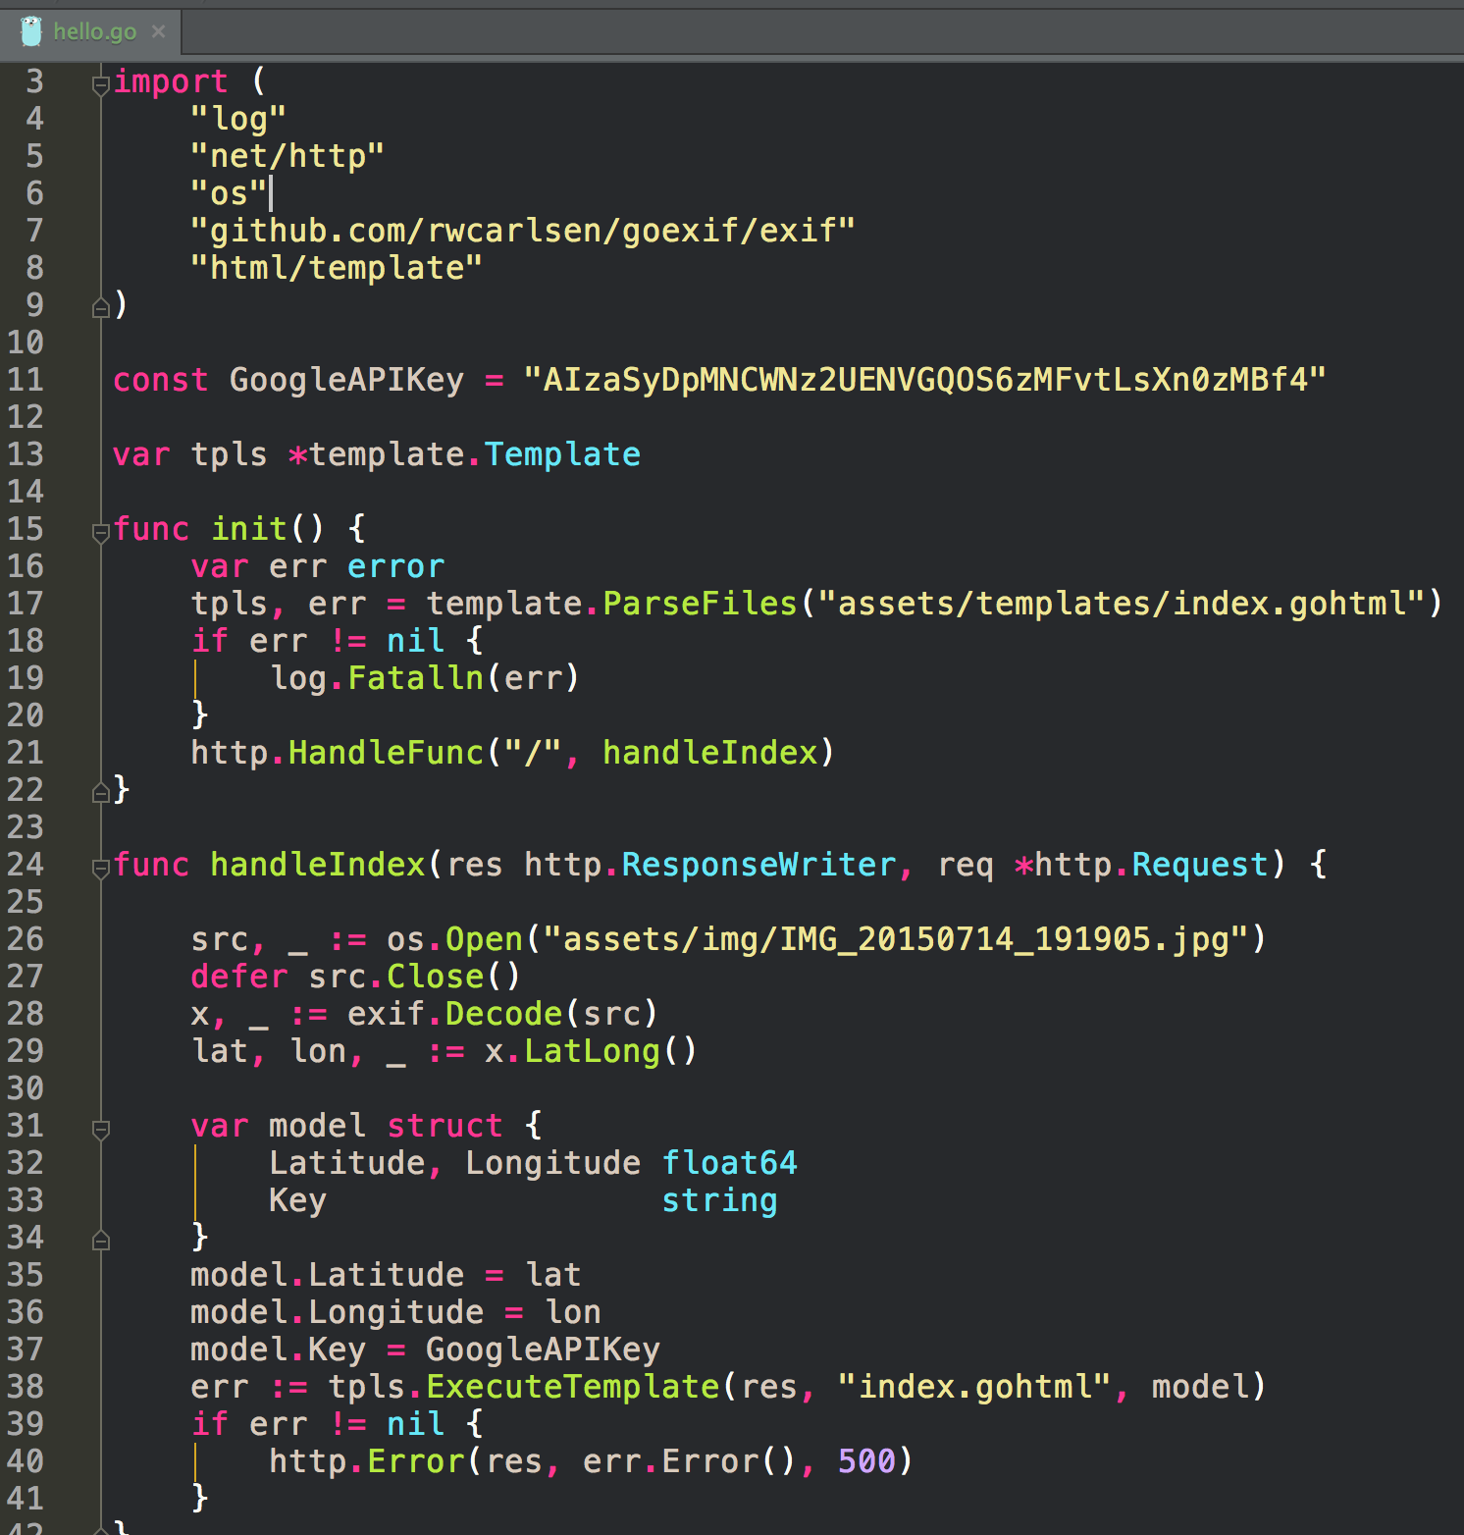
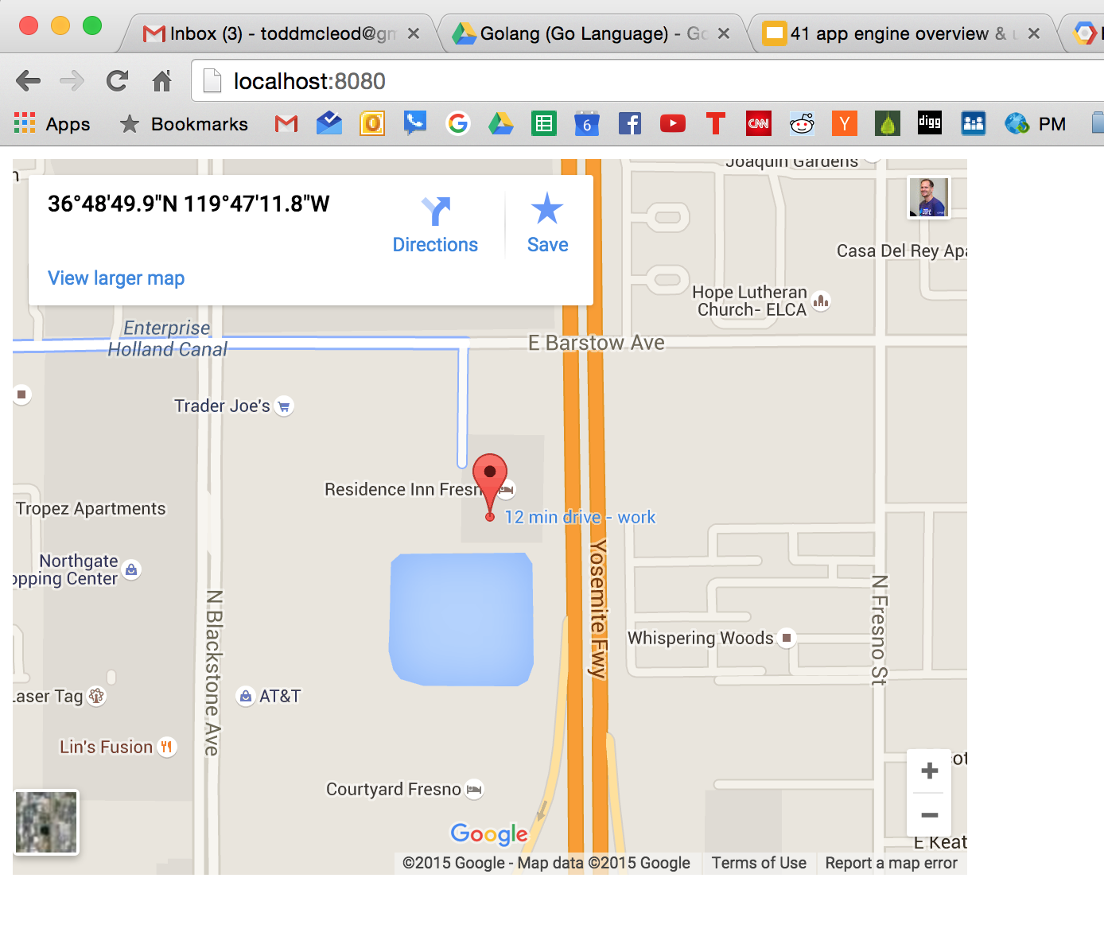

Slide 43
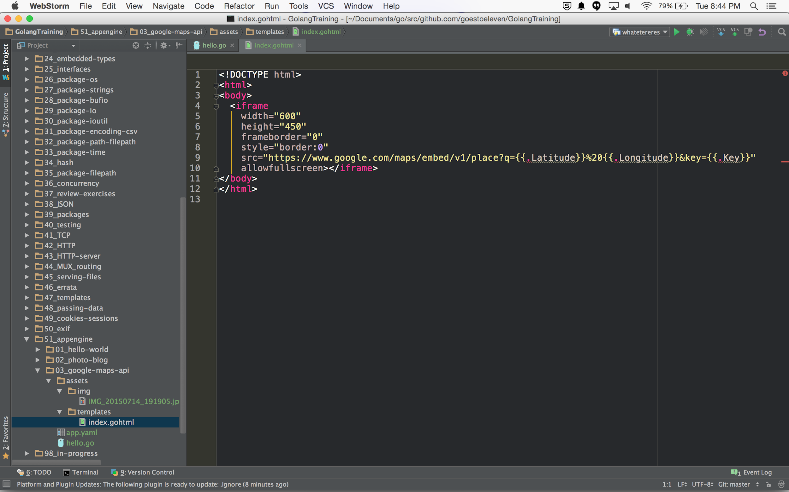

Slide 44
App Engine Services

Slide 45
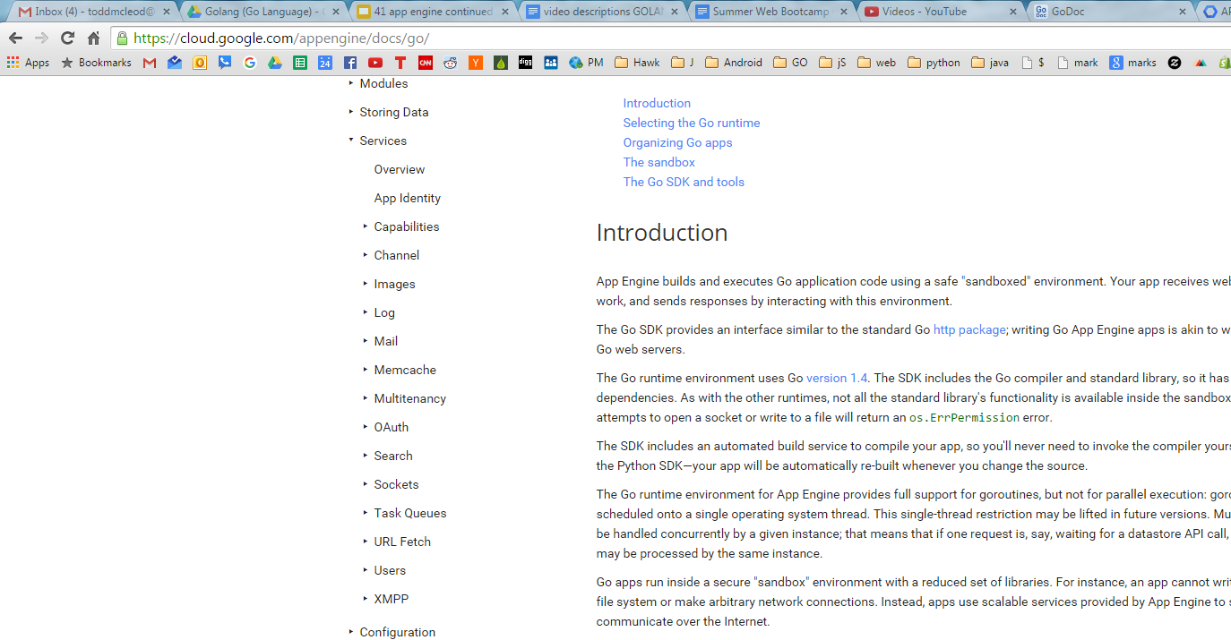
App engine is made up of a lot of services

Slide 46
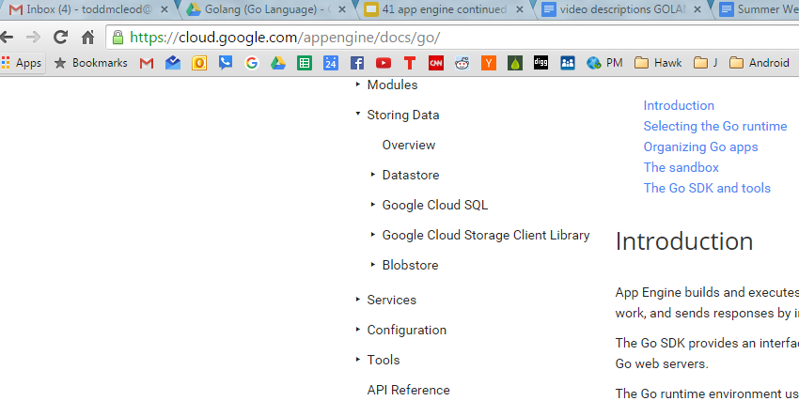
Data Storage

Slide 47
most of your app is
go code
html, css, javascript
using the datastore
storing things in the datastore
retrieving things from the datastore
“Your go code is like the plumbing, connecting your html / css / javascript and the datastore”

Slide 48
USERS
app engine service

Slide 49
logs users in
using their google account

Slide 50
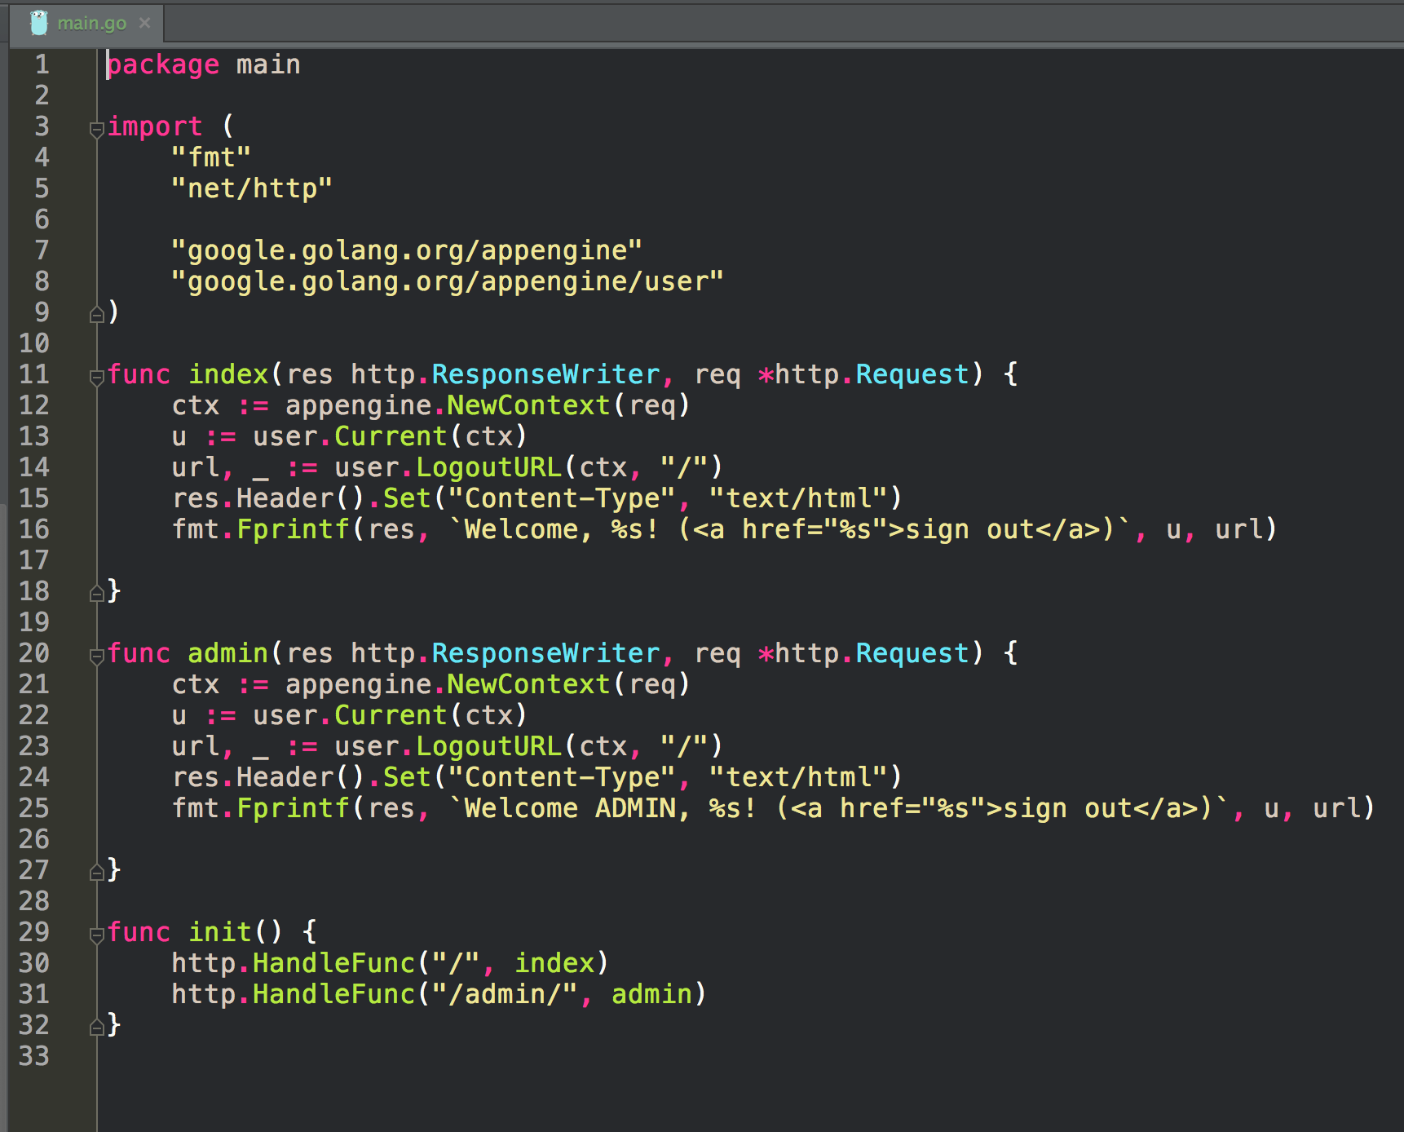
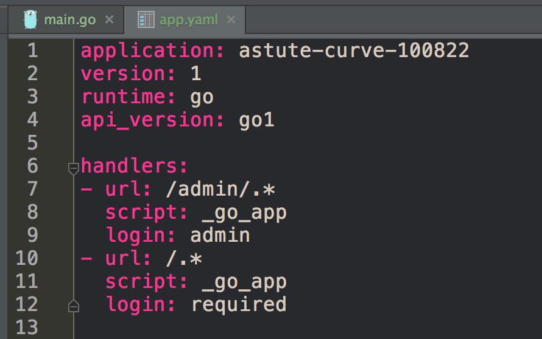

Slide 51
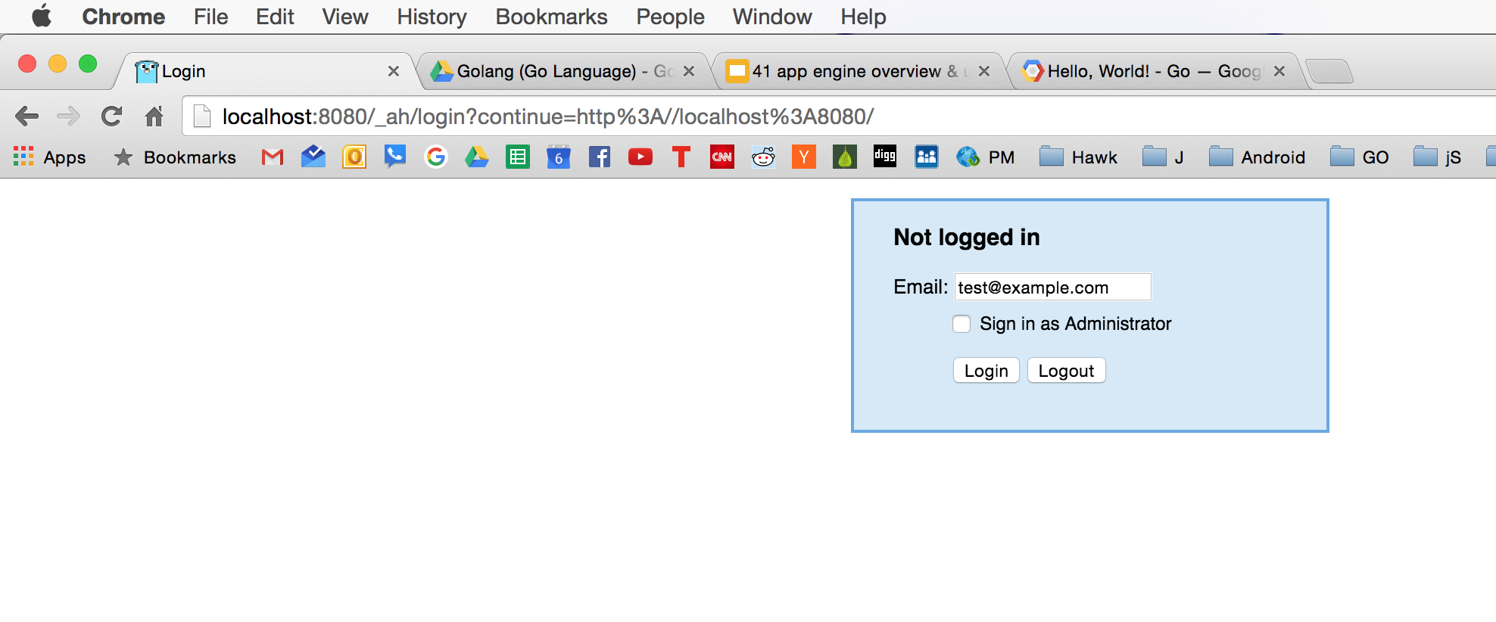
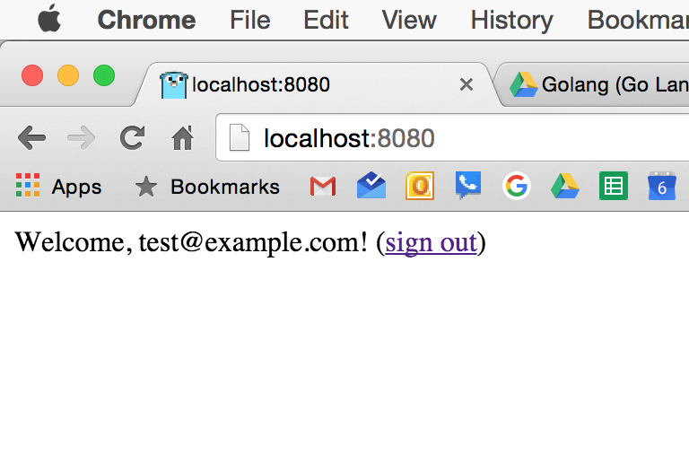
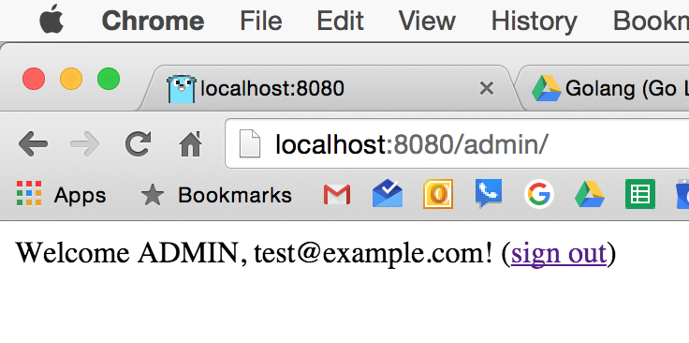

Slide 52
Context
a piece of information that travels along with all of the API requests

Slide 53
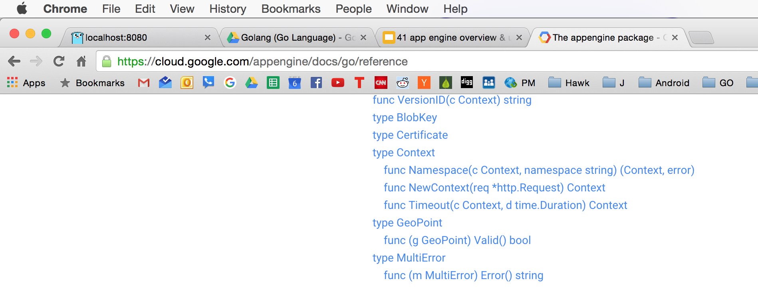

Slide 54
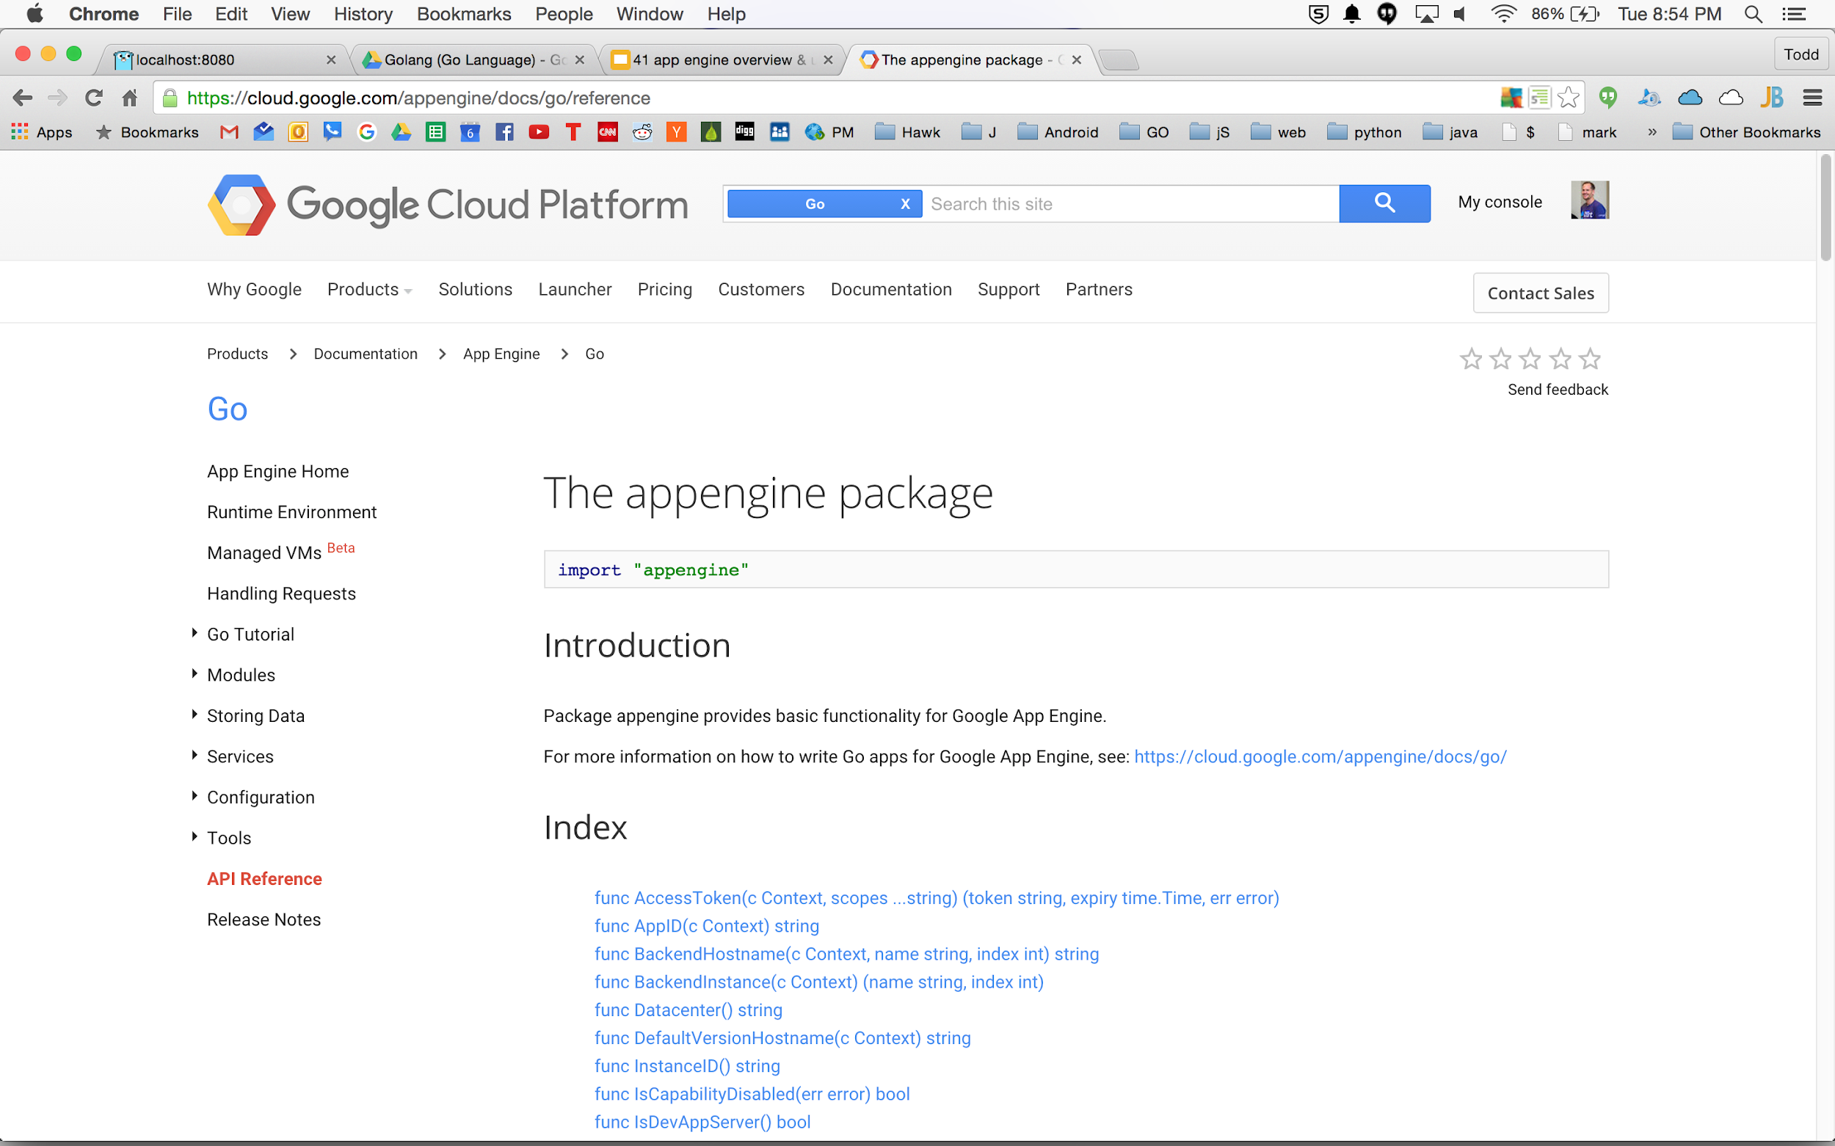

Slide 55
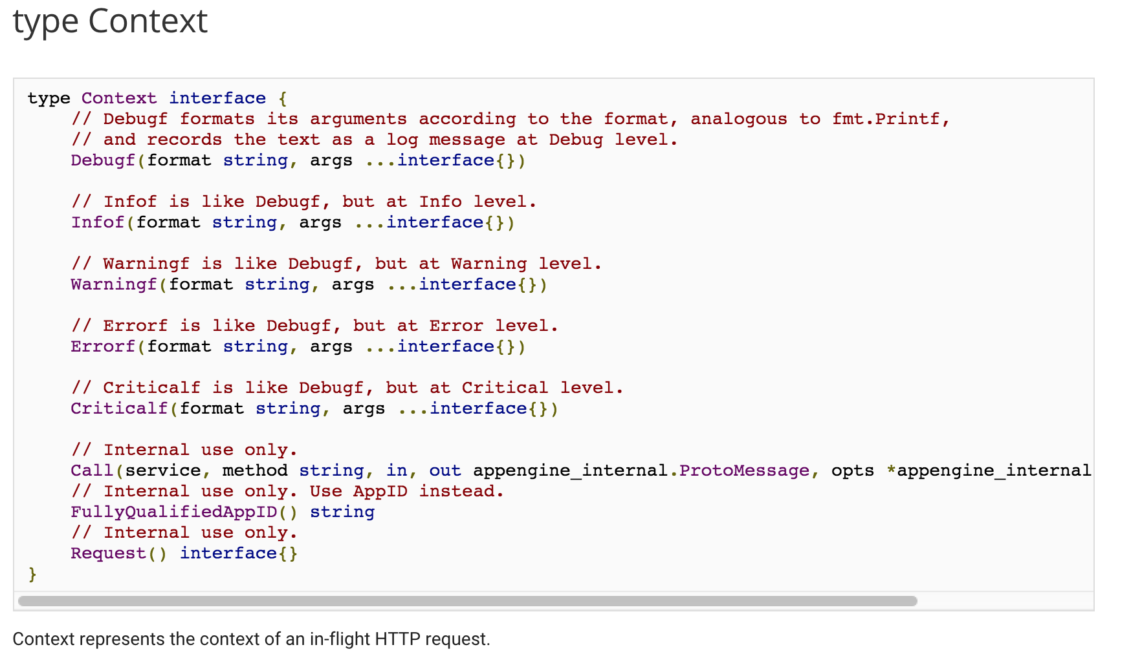
doesn’t provide me with much insight into context

Slide 56
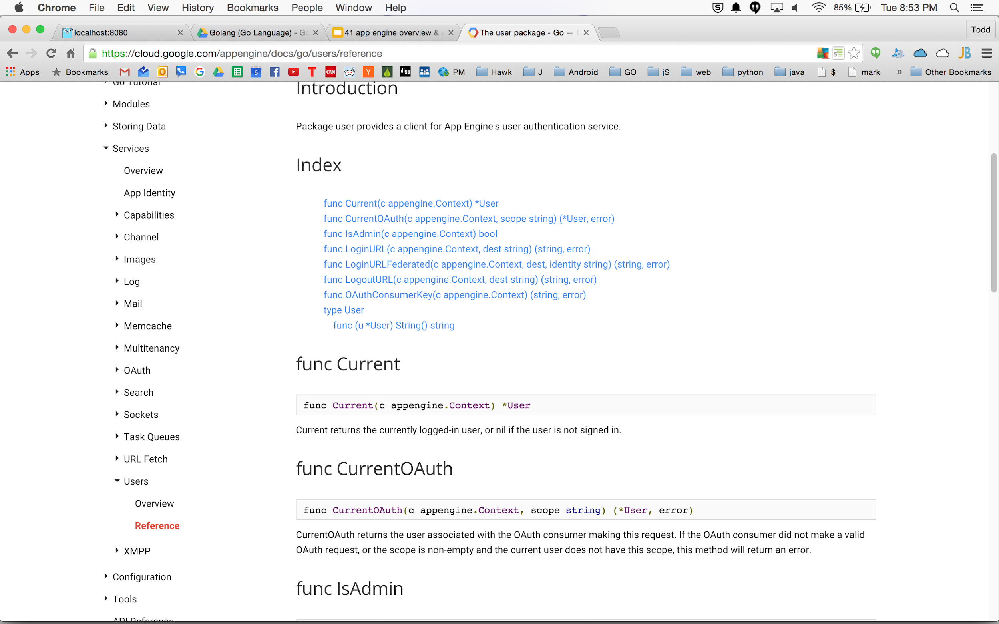

Slide 57
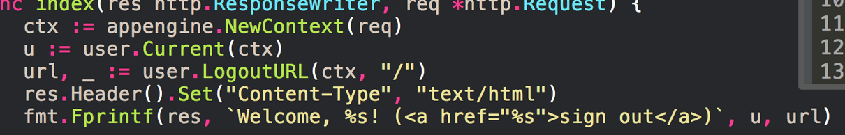
user.Current(ctx)
package.Function(param)

Slide 58
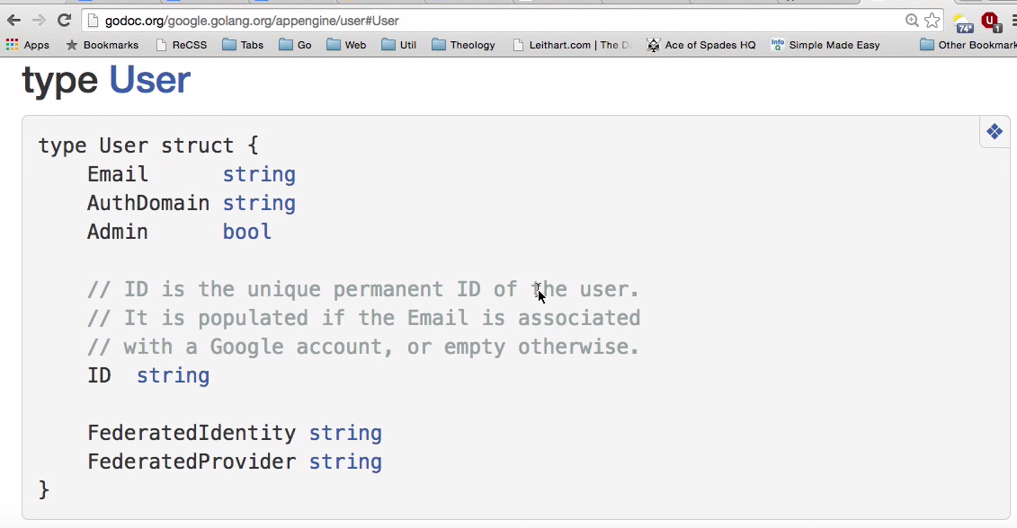

Slide 59
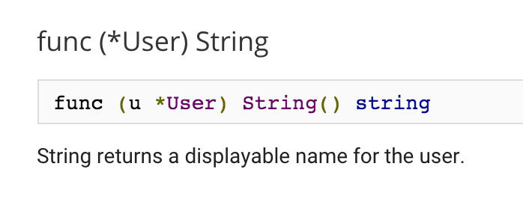

Slide 60
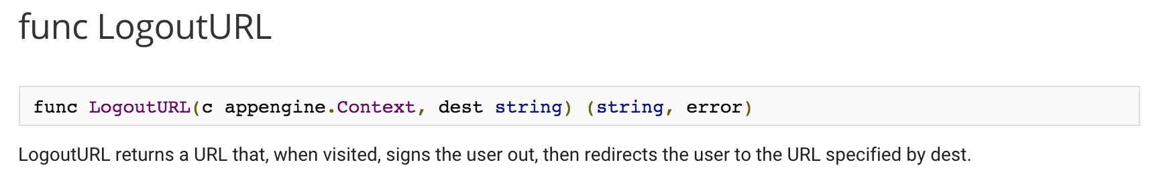

Slide 61
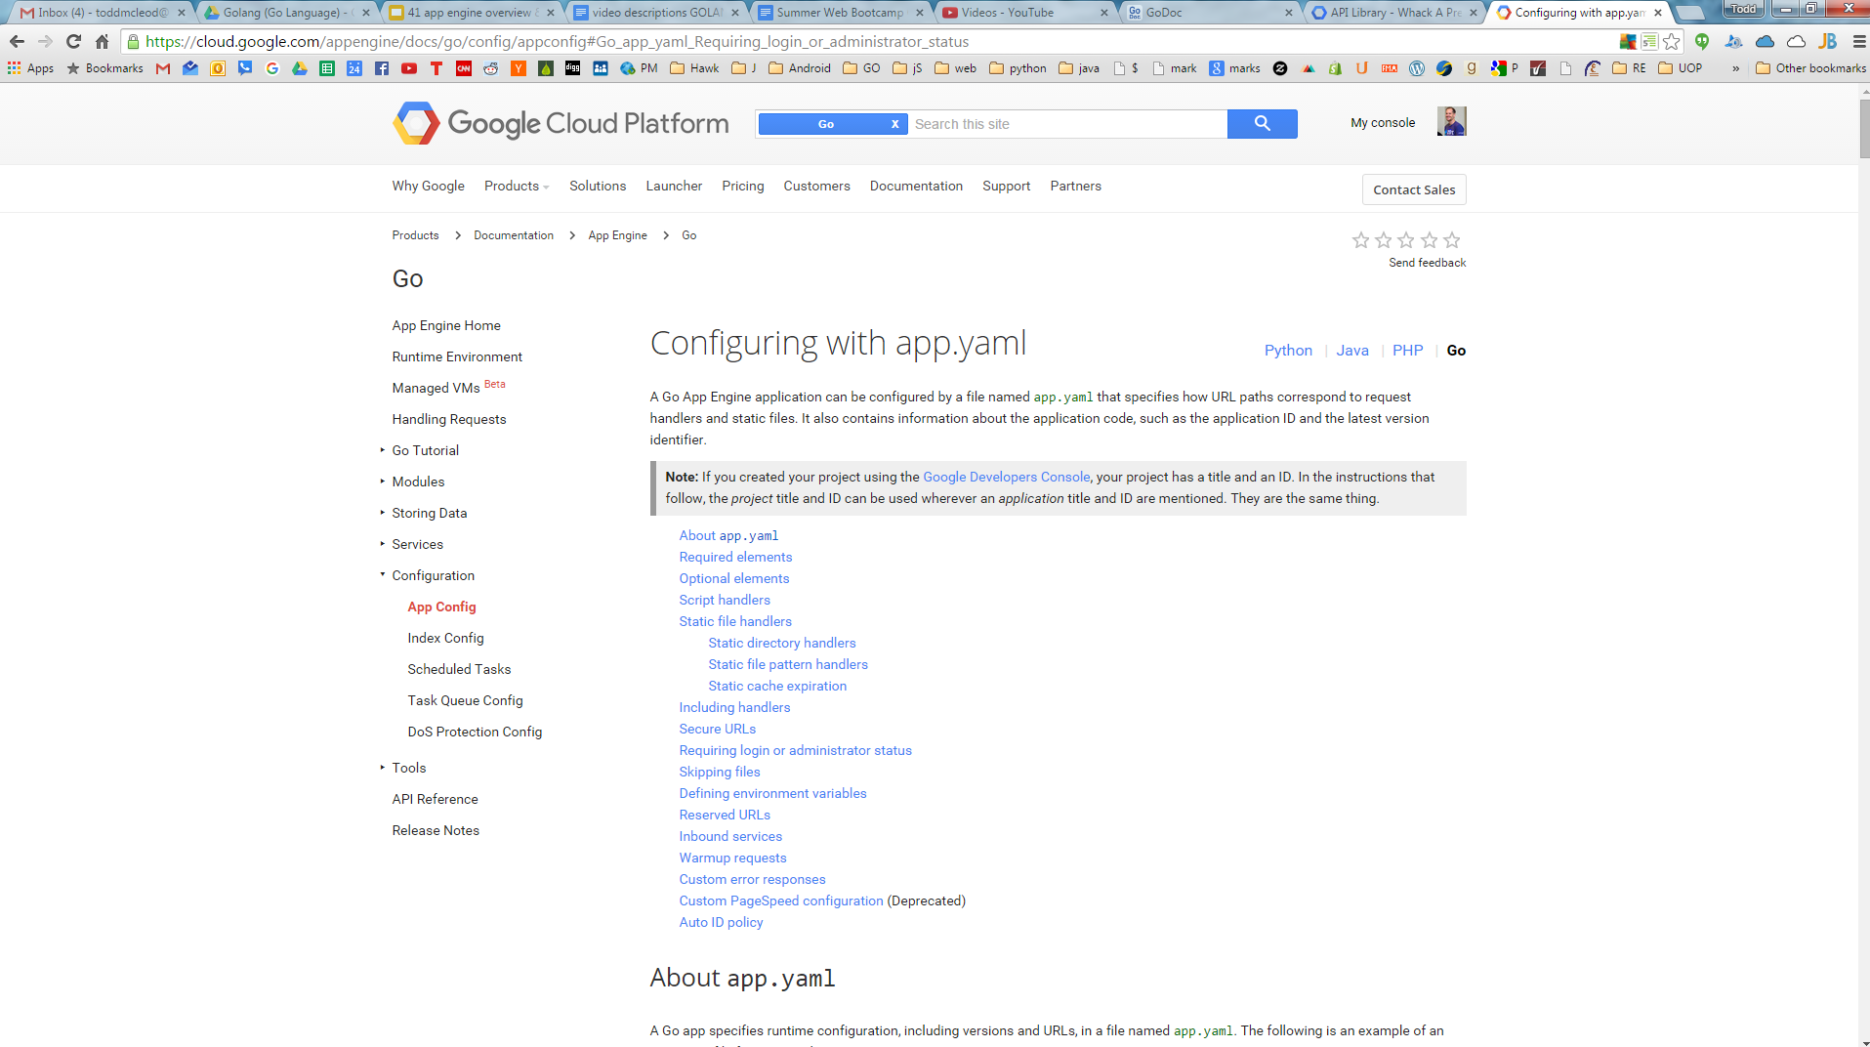

Slide 62
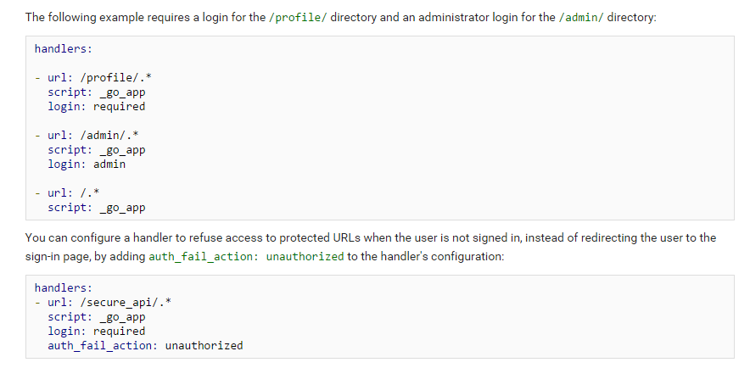

Slide 63
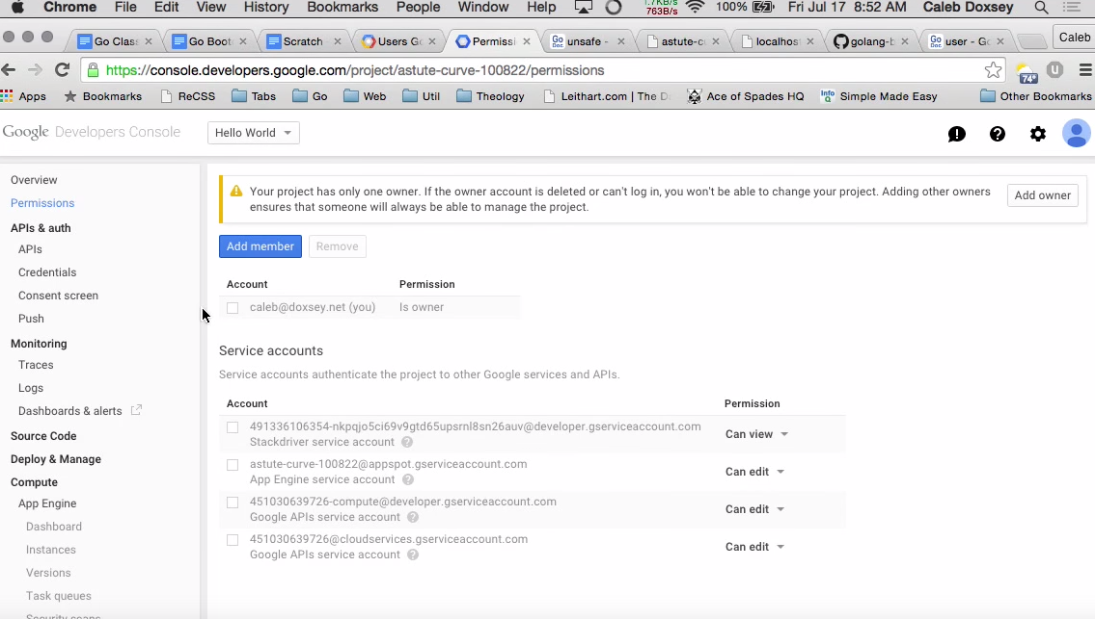
This is where you add/remove people with “admin” credentials

Slide 64
What do you do
if you don’t want to use google logins?

Slide 65
What do you do
if you don’t want to use google logins?
roll your own session management

